Slide 1
Learning Spiral
Business Presentation 2015-16
www.learningspiral.co.in

Slide 2
Our Vision
Agenda
About Learning Spiral
Learning Spiral Differentiators
Why Learning Spiral?
Operation Facilities
Services Portfolio
Publishing Solutions
DigiContent Solutions
Resources Training and Development
Technology and Infrastructure
Contact Us
To be the leading Digital Publishing Solution provider in India by serving our clients beyond their expectations with technology driven approach towards providing innovative, fast, error-free & cost effective services…

Slide 3
About Learning Spiral
Learning Spiral, founded in 1999, possessing immense domain expertise in publishing solutions, evolves with a prophecy of growing into "Partner of Choice" for global clientele. With a rich basket of technology-driven content solutions, Learning Spiral supports the vibrant publishing industry to its core.
Learning Spiral is a landmark by itself and has stood testimony to changes within and outside over the last 5 years. With a work force of over 350 Employees, LSPL is serving the global customers from three delivery centers from Kolkata & Raipur. The resources and technology available on the shop floor enables us to provide time-saving and cost-effective solutions as per client's requirement.
Learning Spiral has digitized over 3.6 Million Pages during last financial year to various formats with top Educational, Professional and STM Publishers and now, is an established provider of digital publishing services to international customers.

Slide 4
Learning Spiral Differentiators
Strategically located in Kolkata, a knowledge hub with abundance of trained resource for publishing
- A low cost hub in comparison to other metros in India with robust BCP
- Giving back more saving to every dollar spent for valued services
- Strong financial backing of parent group for sustainable business growth
- Clear focus, a trusted valued partner for business transparency

Slide 5
Why Learning Spiral?
C-SAT
1
Expansive Portfolio of Offerings
Providing the right set of capabilities for the right opportunities at the right time
2
Global Delivery and Engagement Models Our unique business model for sustainable delivery of high quality, cost effective services around the Globe
3
Technologies Innovative products, tools and methodologies to serve our customers with most cost effective solutions
4
Innovation as a culture
Create a competitive edge for the customers and the organization through innovation and continual improvements
5
Infrastructure
Best-in-class development centers, production facilities across multiple locations to ensure business continuity and client expectation management

Slide 6
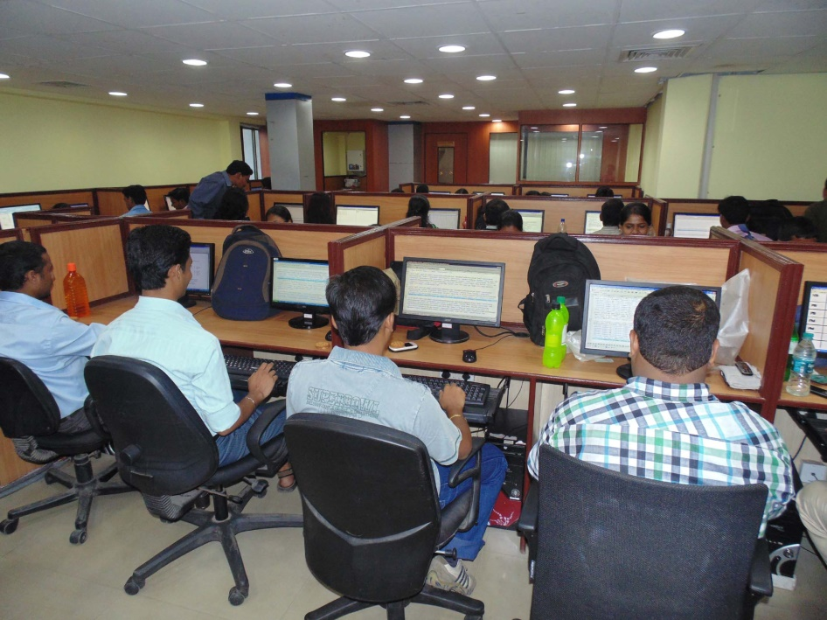
Operation Facilities
2 Operation units at Kolkata, West Bengal and 1 Operation unit at Raipur, Chhattisgarh
Number of workstations – 250+
Three shift operation - 24x7
Skilled operating staff – 350+
24x7x4 SLA for Firewalls, Routers & L3 switches
Staff holidays aligned as per customer business requirement
Facility area – 12,000+ square foot

Slide 7
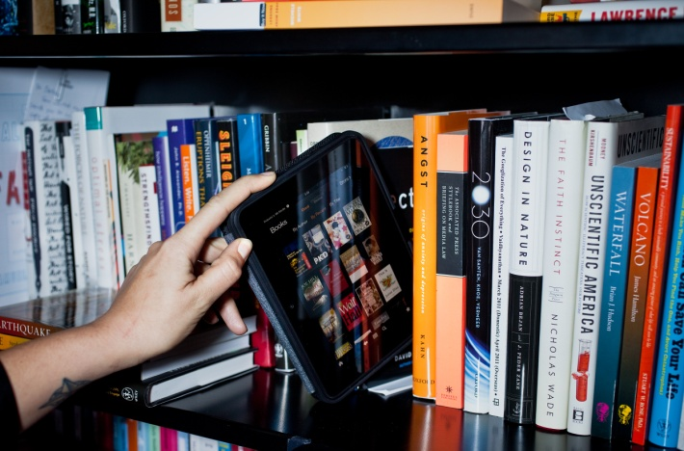
Services Portfolio
Digital Publishing Services
Scanning of Old Documents & Books
Digitization and Preservation of Archival
Data Entry, Double Keying & OCR
HTML/XML/SGML Tagging, TEX/LaTeX Coding
Structuring for Web/Publishing – HTML/XML/CML/MathML
eBooks – ePub/Mobipocket/ePDF/azw
Multi-lingual Capabilities across European languages other than English: Dutch, French, German, Italian, and Spanish
Interactive and Multimedia Content Development

Slide 8
Services Portfolio
Pre-Publishing Services
Production Workflow Management
Expertise in XML/SGML first typesetting workflows to handle jobs of varying complexities
Template Creation, Cover Page design & Graphics Origination
Developed & implemented customized XML workflows in major pagination software (InDesign and LaTeX) Pagination of 1, 2 and 4-color jobs with complicated layout and highly design oriented titles
Editorial, Proofreading & Quality Assurance Services

Slide 9
Services Key Differentiators
- Follow "First Time Right" in Controlled Process
- Tighter Quality Control – 99% Content Accuracy
- Robust Production Tracking System
- Specialized in Handling Display/Inline and Complex Math
- Core Tech Team to Support Complex Tooling Automation
- Best in Business-Class Facility
- Specialized in Speeding Delivery
Flexible Project Delivery Schedule

Slide 10
Resources Training & Development
- At LSPL, we recognize our people as a key resource behind our success. This is why we emphasize first, recruiting the right people, and then, constantly training and re-training them. All our executives and operators are fluent in English and possess a college degree.
- We run regular training programs for operators, proofreaders, writers, and designers at LSPL.
- Customized training is given beforehand for new projects seamless transition.

Slide 11
Technology and Infrastructure
IT Processes and Security: ISO 9001:2008 Framework
- Physical Security – Access control, Security Personnel, Surveillance Camera
- Device Firewall Used at Locations (UTM 150 Quick Heal)
- Secure Branch Office and Client Site VPN Connectivity
- Antivirus/Spyware Threat Management – Quick Heal Enterprise Server
- Periodic Security Audits
- Vendor Management – Ensuring Conformance of SLA
Backup, Redundancy & DR
Servers with Intel Xeon Processor, RAM: 8 GB, HDD: 500 x 3 GB (RAID 5)
- 24x7x4 SLA for Firewalls, Routers & L3 switches
- 8 mbps Leased Line Internet Connectivity
- Standardized Back-Up Systems

Slide 12
For Your Valuable Business Queries, Please Contact Us:
Corporate Office: 3A, Auckland Place, 5th Floor, Kolkata – 700017 (India)
USA Office: 524 Sunset View Drive, Davenport, FL 33837, USA
Phone: +91 33 4012 4112
Contact Person:
Mr. Krishan Mohta, Director
+91 98300 48798
krishan@learningspiral.co.in www.learningspiral.co.in

Slide 13
THANK YOU!!!

